Slide 1
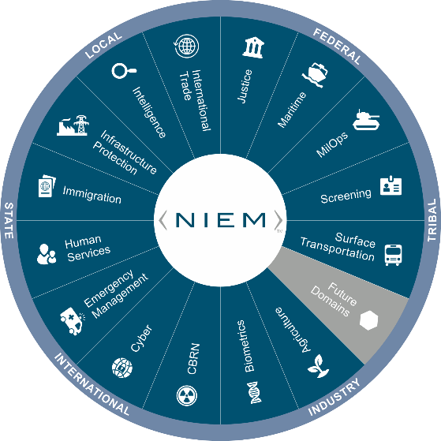
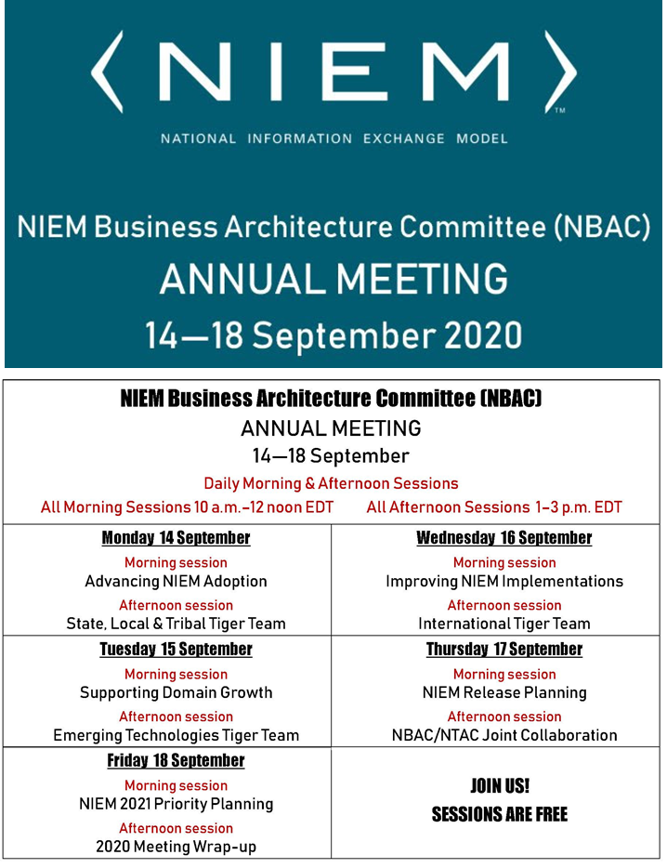

Virtual Annual Meeting (NBAC)
16 September 2020 → 10AM-12PM
Improving NIEM Implementation
Thomas Krul
NBAC Co-Chair
Enterprise Architect
Public Safety Canada
Thomas.krul@canada.ca

Slide 2

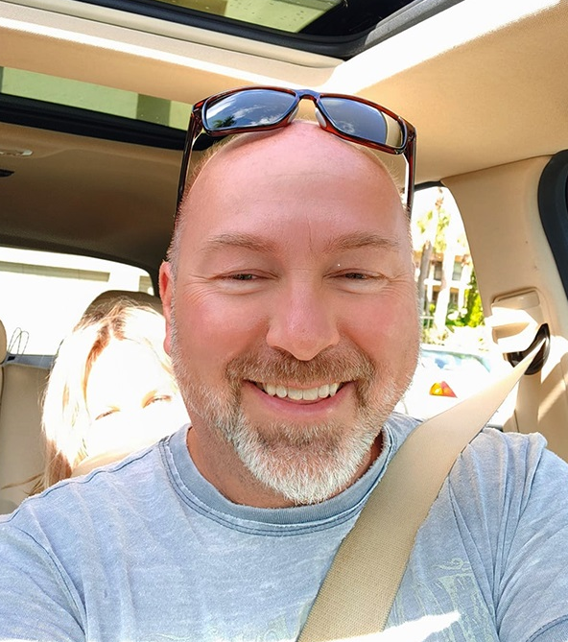
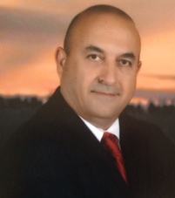


Housekeeping
Speakers
Primary Facilitator
Thomas Krul
Support Facilitator
Kamran Atri
Guest Speaker
Jonathan Kirk
Treasury Board Secretariate
Session:
Improving NIEM Implementation
Keep in mind:
Sessions will be recorded and may be used for training and communications purposes.
Ask questions in chat anytime
To pose a question by voice, “Raise Your Hand” & wait for the facilitator to call on you
Don’t be shy, share your knowledge and ideas!
This session’s briefing will be available on Github for download
2

Slide 3
Session agenda
Introduction
Guest Speaker: Johnathan Kirk, TBS
What do we mean by “improving the implementation”?
Ways to improve the implementation

Slide 4
Johnathan Kirk
Treasury Board Secretariat
The Treasury Board of Canada Secretariat provides advice and makes recommendations to the Treasury Board committee of ministers on how the government spends money on programs and services, how it regulates and how it is managed. The Secretariat helps ensure tax dollars are spent wisely and effectively for Canadians.

Slide 5
What do we mean by “Improving niem implementation”?
The NIEM vision is to elevate data as a strategic asset by advancing the NIEM community-based standards framework to improve data interoperability and support existing and emerging technologies among federal, state, local, tribal, industry and international partners.
… but
You can’t achieve a vision like that unless folks are happy with the implementation. And by “implementation”, we can mean:
How useful the model is (scope),
How easy the model is to implement within one’s system (training), and
How well the model can be implemented within one’s system (tools).

Slide 6
scope
It’s not just a canonical model, it’s also…
Governance
Mature
Open
Solution-focused, benefits-rich

Slide 7
Scope/Governance
The cost and complexity to stand up a governance structure like this is huge
Ensures health and growth of the entire NIEM ecosystem
Ensures implementation is always moving forward

Slide 8
Scope/mature
Domains
Subject matter experts
Technical experts
Adoption
3rd Party software

Slide 9
Scope/open
XML, JSON, UML...
mobile device exchanges and application program interface (API), micro and web service reuse
Inclusive
Malleable

Slide 10
Scope/solution-focused, benefits-rich
Plenty of problems out there begging to be solved
Growth with new Domains/uses/new technology
Standards and policy-based support

Slide 11
training
Provide NIEM tool training to improve understanding and proficiency in building extension schemas, augmentations, and implementation.
Recommend specific training objectives be identified with associated curricula for adopters, modelers, developers, and users to achieve and demonstrate (test) level of NIEM proficiency.
Review and Update NIEM Training artifacts and approach
Identify NIEM Trainer candidates
Support training in universities, colleges, in Government curriculum

Slide 12
Tools
Creating and improving the tools users need to help implement NIEM
Messaging
Planning (EA Tools)
Conversion tools
Data Management

Slide 13
Tools/Messaging
IEPD Registry
NIEM Public Registry
NIEM Restricted Repository, and
NIEM Public Repository
Identify ownership and usage of IEPDs
Share and harmonize IEPDs
Provide an easy browsing tool for NIEM core and Domain content

Slide 14
Tools/planning
Facilitate and automate all phases of the NIEM IEPD Lifecycle, including tools to trace information exchange requirements from architecture scenario planning artifacts to mapping extract, transform, load (ETL) operations, IEPD implementation, and IEPD posting for discovery and reuse
Document EA "as is" and "to-be" architectures and exchange models.
UML for NIEM
Rendering NIEM data definitions as UML models for incorporation into existing UML class diagram usage patterns
Enabling the construction of new conformant NIEM data definitions by people using UML tools.

Slide 15
Tools/conversion tools
Implementation of Meta-Model to provision Tool Strategy
Environment that supports xml, json, mobile device exchanges and application program interface (API), micro and web service reuse.
NIEM XML to JSON Conversion
Alternate representations of NIEM xml (e.g. JSON, UML, etc.) to make it easier for tool developers to work within the NIEM framework

Slide 16
Tools/data management
Develop Privacy Sensitivity Marking and additional guidance on authorization for access to NIEM-exchanged data

Slide 17
Improving the implementation of NIEM conformant information exchanges
Conversation – do we have anyone who has implemented? Get names
What were some of the risks and challenges of implementing exchanges?
NIEM acceptance as part of a suite of approved standards

Slide 18


Slide 19
Closing Remarks
19

Slide 20
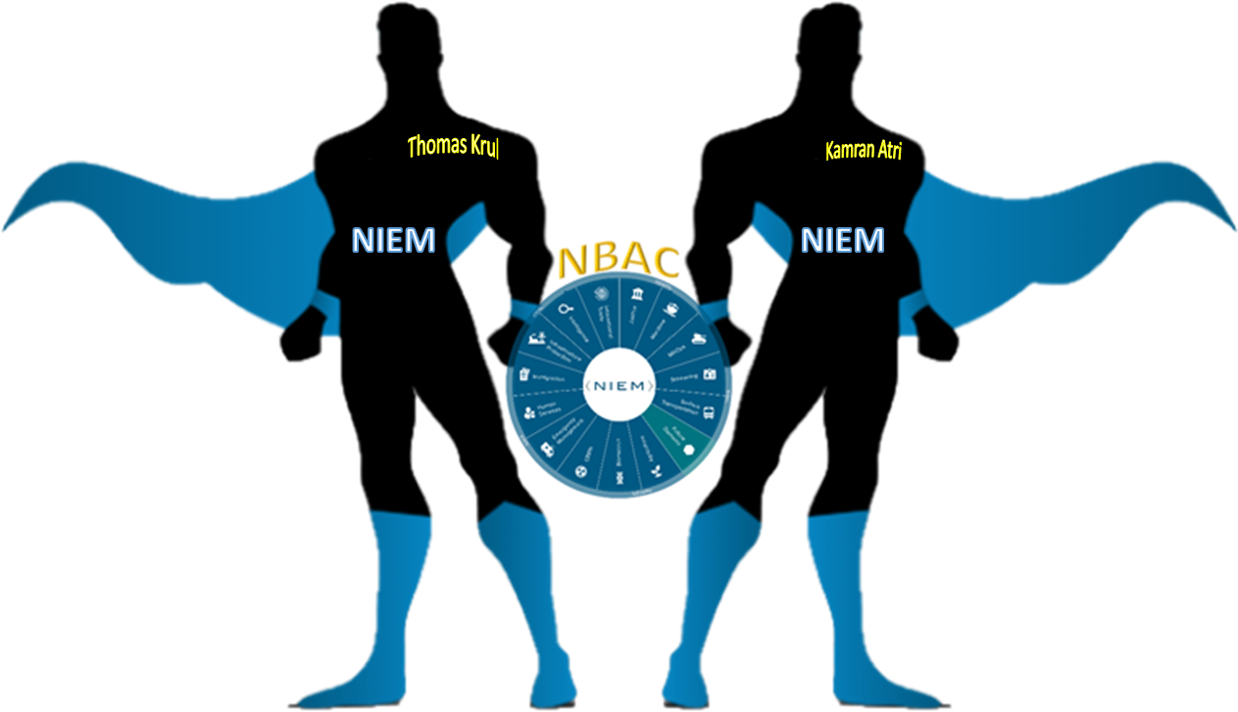
Enabling Connected Future Now
NBAC Co-Chairs
Thomas Krul
Kamran Atri
thomas.krul@canada.ca
katri@A4SAFE.COM
20

Slide 21
Annual Meeting Overview (14-18 September)
NBAC Session | Event Date/ Time | Topic | Primary Facilitator (s) | Support Facilitator (s) | Guest Speaker (s)
1 | Monday, 14 SEP 10 - 12 AM | Advance NIEM Adoption | Kamran Atri | Thomas Krul | Kshmendra Paul
2 | Monday, 14 SEP 1 - 3 PM | State, Local, Tribal Tiger Team | Cait Ryan / Tom Carlson | Thomas Krul | Eric Sweden (NASCIO)
3 | Tuesday, 15 SEP 10 - 12 AM | Support Domain Growth | Kamran Atri | Thomas Krul | Brian Gattoni (DHS CISA CTO)
4 | Tuesday, 15 SEP 1 - 3 PM | Emerging Technologies Tiger Team | Jalal Mapar | Lain McNeill | Syed Mohammed
5 | Wednesday, 16 SEP 10 - 12 AM | Improve NIEM Implementation | Thomas Krul | Kamran Atri | Johnathan Kirk (TBS)
6 | Wednesday, 16 SEP 1- 3 PM | International Tiger Team | Thomas Krul | Kamran Atri | Poewan Lao
7 | Thursday, 17 SEP 10 - 12 AM | NIEM Release Planning | Christina Medlin | TBD | N/A - Working Session
8 | Thursday, 17 SEP 1- 3 PM | NBAC/NTAC Collaboration Planning | Kamran Atri/ Web Roberts | Thomas Krul/ Dr. Scott Renner | N/A - Working Session
9 | Friday, 18 SEP 10 - 12 AM | NIEM 2021 Priority Planning | Katherine Esobar | Stephen Sullivan | Stuart Whitehead
10 | Friday, 18 SEP 12 -12:15 PM | WRAP-UP/Adjourn | Kamran Atri / Thomas Krul | Stephen Sullivan | N/A

